Slide 1

UX Design

Slide 2


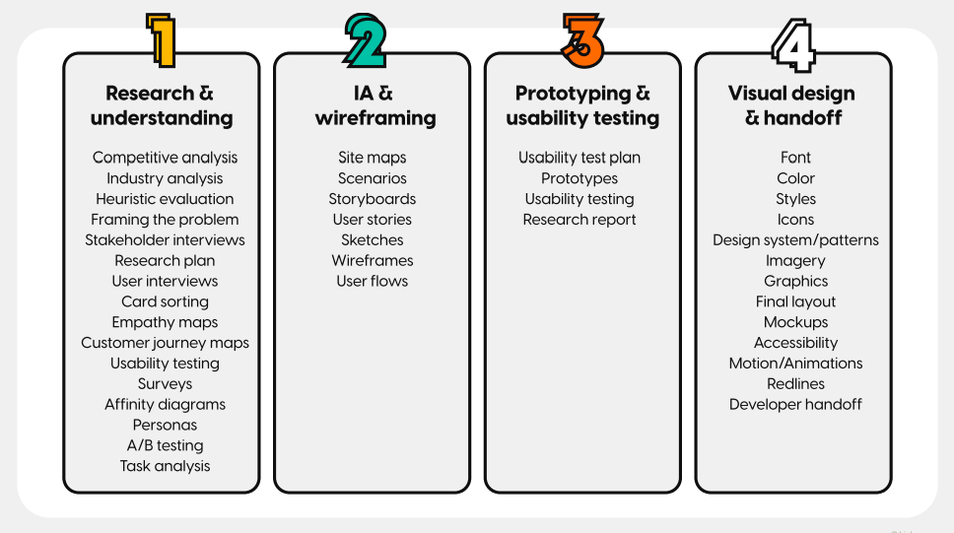
BEFORE CLASS
Before this course
30 MIN
Watch this video
Understand what are the 4 main stages of UX Process?
Write down what you didn’t understand
https://www.youtube.com/watch?v=12ZyQZDqLJk

Slide 3
UX Course Agenda
DAY 1
DAY 2
0 Introduction On UX Design
1 Framing the problem
2 User interviews
3 Analyzing the competition
Sketching
User flows
Usability principles

Slide 4
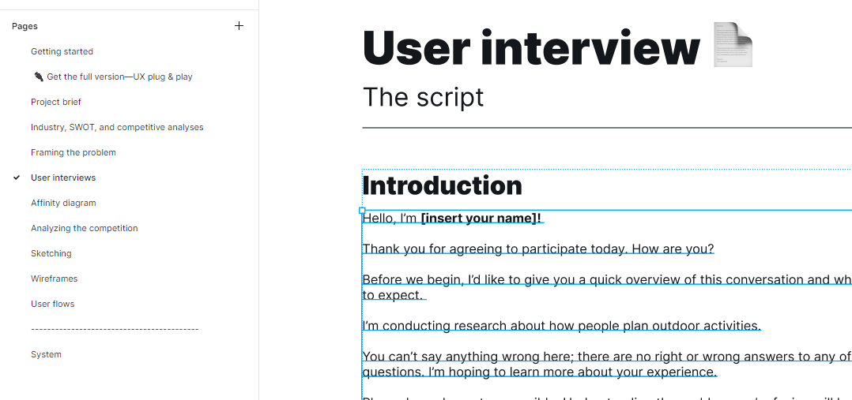
EXPLAIN
Figma template overview
10 MIN
This template guide you along your UX process
Your work
And
corrections
How to use this template? Watch the video:
https://www.youtube.com/watch?v=EkgM7m4UJA0
Notes:
Open the FIGMA template
Any help ?
https://www.youtube.com/watch?v=EkgM7m4UJA0
Present the 5 steps covered on this UX course
1 - Framing the problem
2 - User interviews and affinity diagram
3 - Analyzing the competition
4 - Sketching
5 – draw Wireframes and User flows

Slide 5
Teams of 2 or 3 !
Divide your VC team in 2 subgroups

Slide 6
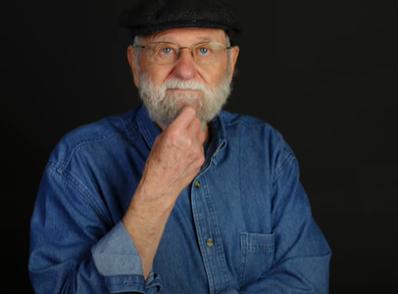
WATCH
User centered design
10 MIN
Don Norman is a famous researcher on UX Design
Watch the video
Discuss in groups : What is the key message of Don Norman?
https://www.youtube.com/watch?v=JgPppwsocRU

Slide 7
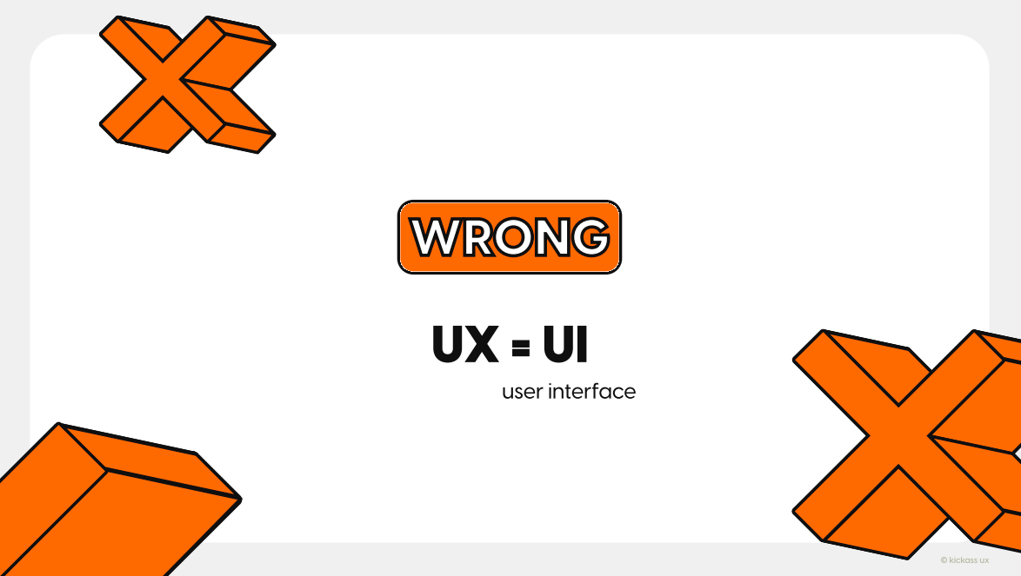
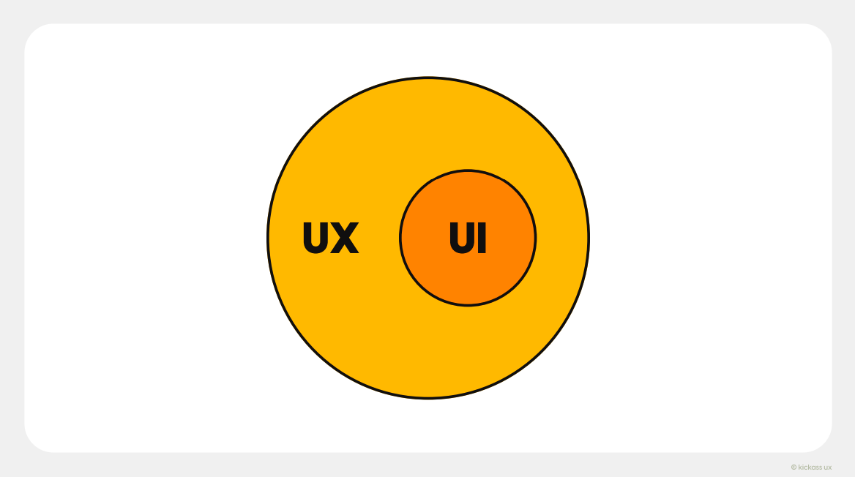
EXPLORE
The 6 Biggest Misconceptions about UX
10 MIN
Watch the video
Discuss in groups about the 6 misconceptions about UX
https://www.youtube.com/watch?v=loFYcVpWjFc

Slide 8
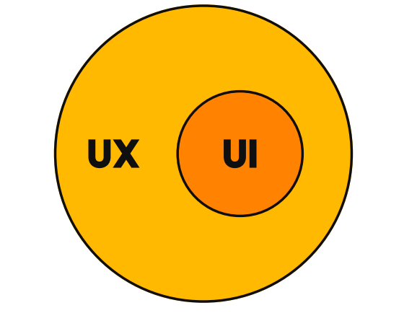
EXPLAIN
Difference between
User Interface and User eXperience
05 MIN
UI is focused on how a product’s surfaces look and function
UX is focused on the user’s journey to solve a problem
Think of UI as a subset of UX.
Notes:
UX is not equal to UI.
UI stands for user interface, which refers to the visuals that a user interacts with in a product or service. It connects the user with a product's functionality. In the job title UX designer, the word that everyone gets caught up on is "designer" and traditionally that meant working on the aesthetic of a product. While UI plays a role in UX. It's only one of the things that UX designers tackle on a daily basis. Think of UI as a subset of UX.

Slide 9



EXPLAIN
Food Delivery App
05 MIN
With a good UI
But a bad UX
Visually appealing and sleek interface
Beautiful food images
Attractive colors
Smooth animations
Lacks of clear navigation,
Confusing checkout process
Fails to provide accurate delivery estimates

Slide 10

ACTIVITY
Social Media Platform
05 MIN
With a good UI
But a bad UX
Visually appealing designs
attractive profiles
Creative layouts
the app bombards users with irrelevant ads
Find 2 more bad UX
EXAMPLE
makes it challenging to control privacy settings,
confusing algorithm that displays irrelevant content

Slide 11

ACTIVITY
A E-commerce Website
05 MIN
With a good UI
But a bad UX
high-quality product images
smooth navigation,
an attractive checkout process.
the site has hidden shipping costs
Find 2 more bad UX
EXAMPLE
complicated return policy,
lack of customer support
Notes:
Solution

Slide 12

EXPLAIN
The process of making a product or service useful, relevant, and meaningful
10 MIN
You wanted Thai Food, but you got Mexican food !!
Watch from 0:45 to 2.40
https://www.youtube.com/watch?v=12ZyQZDqLJk
Notes:
UX is not equal to UI.
UI stands for user interface, which refers to the visuals that a user interacts with in a product or service. It connects the user with a product's functionality. In the job title UX designer, the word that everyone gets caught up on is "designer" and traditionally that meant working on the aesthetic of a product. While UI plays a role in UX. It's only one of the things that UX designers tackle on a daily basis. Think of UI as a subset of UX.

Slide 13
UX Course Agenda
DAY 1
DAY 2
0 Introduction On UX Design
1 Framing the problem
2 User interviews
3 Analyzing the competition
4 Sketching
5 Usability principles
6 Wireframes
7 User flows
8 UX tests (optional)

Slide 14
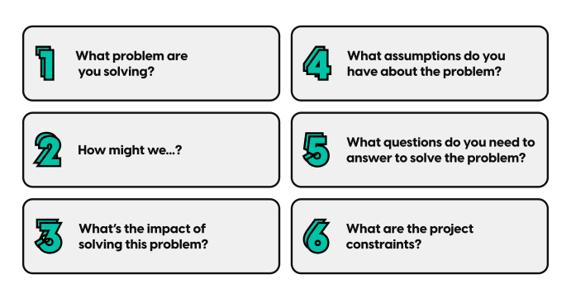
WATCH
Framing the problem
10 MIN
Watch the video
Discuss in groups : did you understand the 6 steps of problem framing?
https://www.youtube.com/watch?v=-dSz0_EAjjA

Slide 15
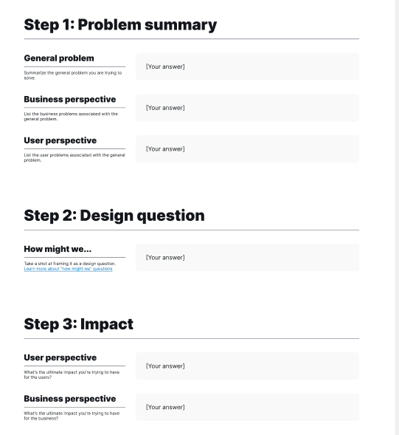
ACTIVITY
30 MIN
1 – In sub groups, review :
Your project problem
Your design solution
The impact of your solution
2 – Review you work with the full VC groups
Notes:
- Should be around what you decided for you proposal 1
- You can have a look at the correction, as example

Slide 16
UX Course Agenda
DAY 1
DAY 2
0 Introduction On UX Design
1 Framing the problem
2 User interviews
3 Analyzing the competition
4 Sketching
5 Usability principles
6 Wireframes
7 User flows
8 UX tests (optional)

Slide 17
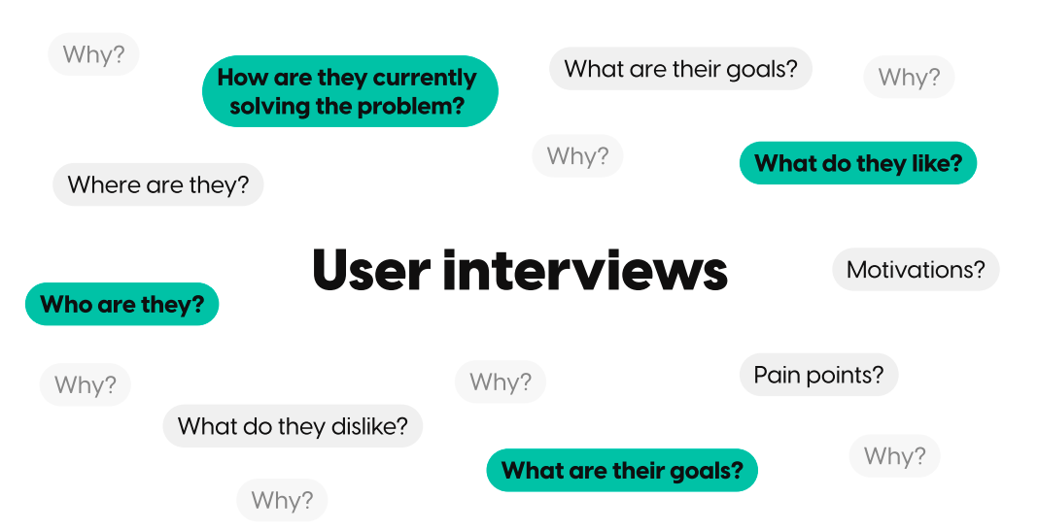
WATCH
User interview
10 MIN
Watch the video -
Discuss in groups : did you understand the 6 rules of user interviews ?
https://www.youtube.com/watch?v=sVUKjCkEt3I

Slide 18
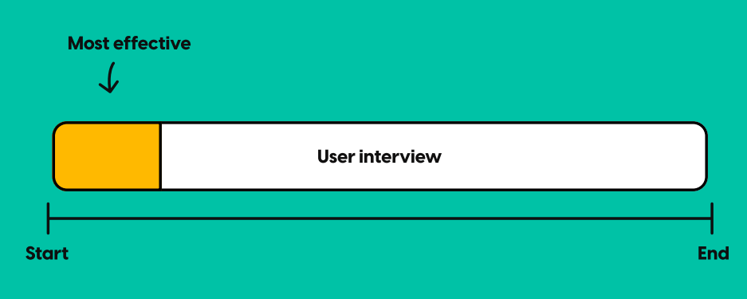
Schedule the most important
questions at the beginning

Slide 19
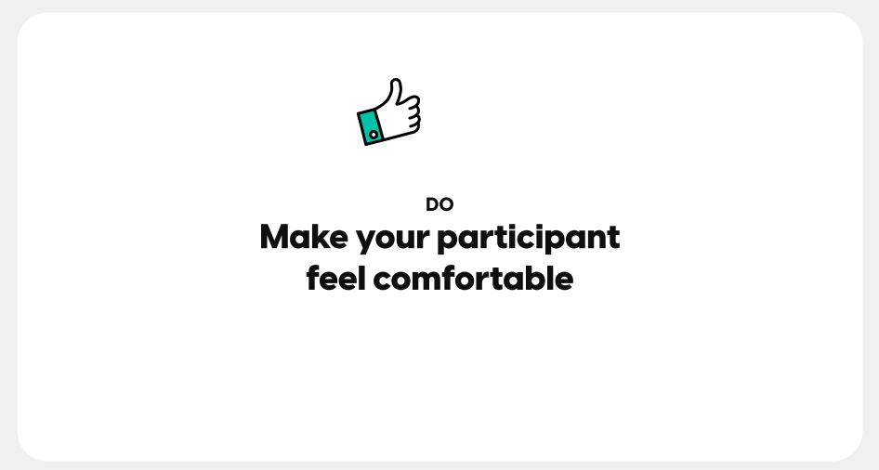
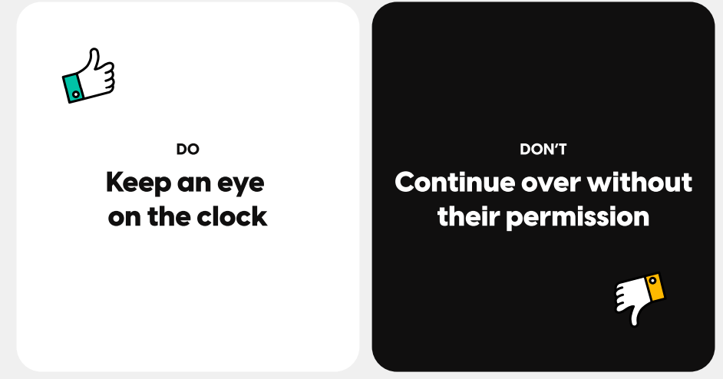
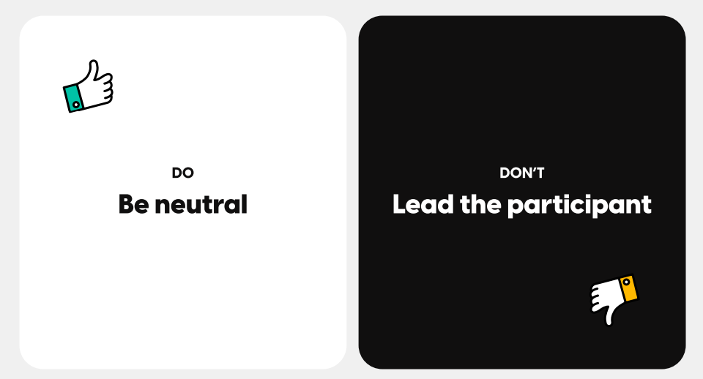
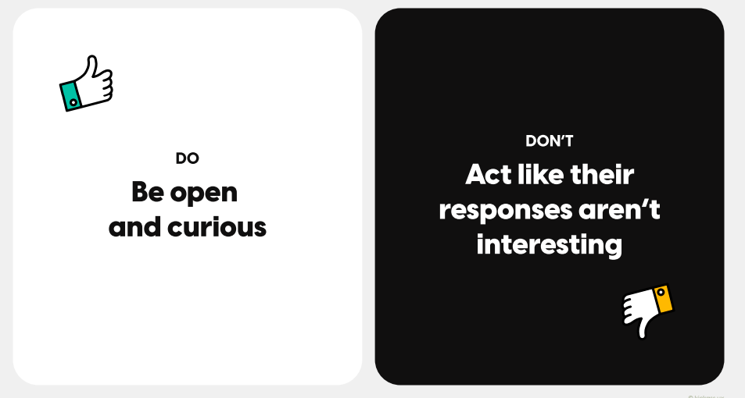
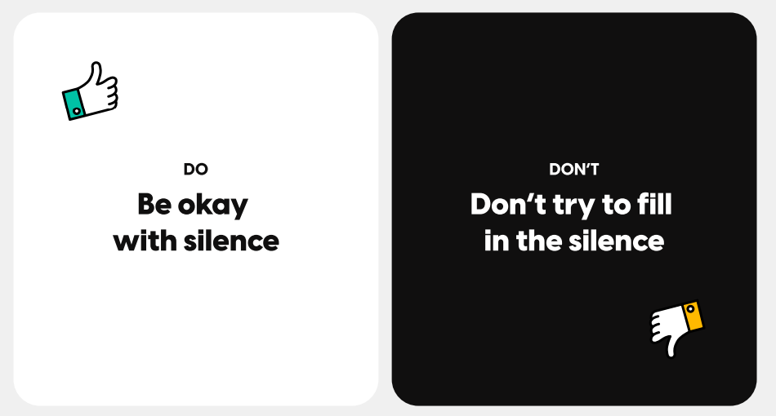
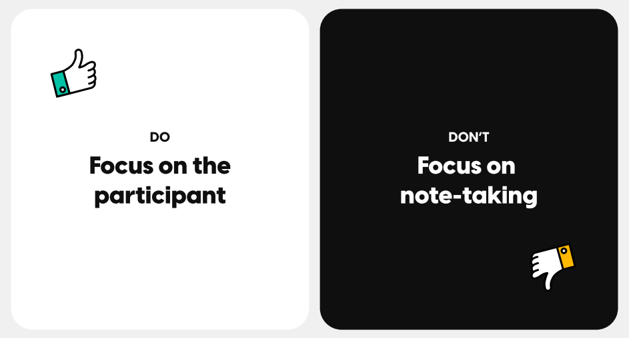
DO’S & DON’TS

Slide 20
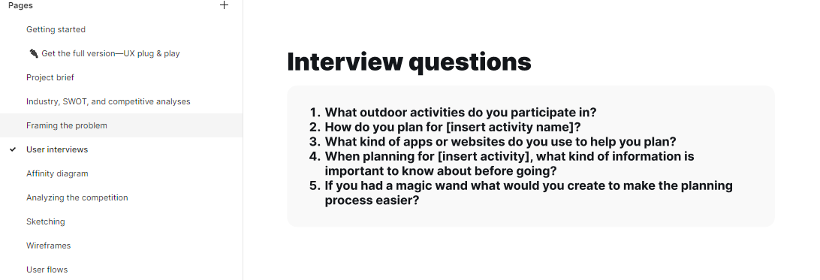
ACTIVITY
30 MIN
2 – Review you work with the full VC group
3 – During the week, plan an 15 min interview with someone corresponding to your persona
1 – In sub groups, brainstorm:
Which persona do you want to interview?
What are the 3-5 interview questions?

Slide 21
UX Course Agenda
DAY 1
DAY 2
0 Introduction On UX Design
1 Framing the problem
2 User interviews
3 Analyzing the competition
4 Sketching
5 Usability principles
6 Wireframes
7 User flows
8 UX tests (optional)

Slide 22
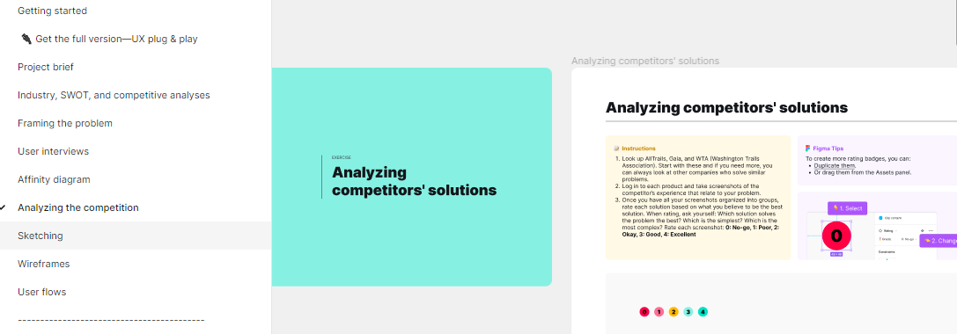
ACTIVITY
30 MIN
2 – Review you work with the full VC group
3 - Which solution solve the problem the best?
4 – What is missing on competitors product that you solution will provide?
1 – In sub groups, brainstorm:
Research competitors' products that are similar to your problem
Paste the screenshots of the products you have found

Slide 23
UX Course Agenda
DAY 1
DAY 2
0 Introduction On UX Design
1 Framing the problem
2 User interviews
3 Analyzing the competition
4 Sketching
5 Usability principles
6 Wireframes
7 User flows
8 UX tests (optional)

Slide 24
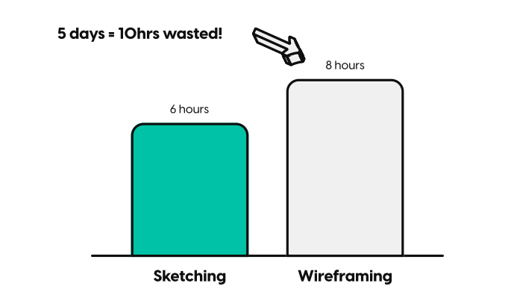
WATCH
Sketching
10 MIN
Watch the video -
Discuss in groups :
Difference between sketching and wireframing?
Why sketching is important ?
https://www.youtube.com/watch?v=eT-m_XJN0FU

Slide 25
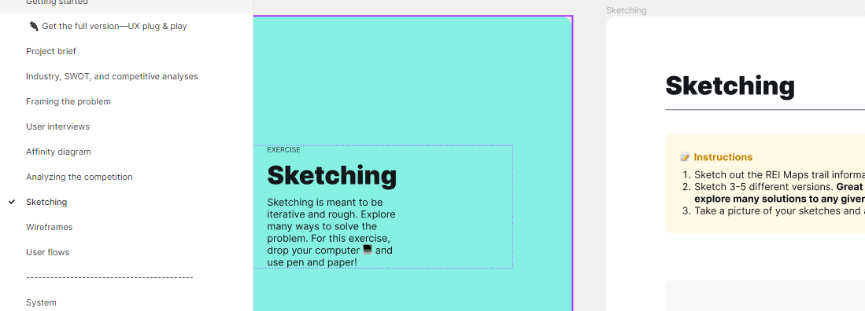
ACTIVITY
30 MIN
2 – Review you work with the full VC group
1 – In sub groups, brainstorm:
Great UX design already explore many solutions
Explore on paper many solutions
You can check the proposed example

Slide 26

Videos and links
DAY 1
Introduction to UX
https://www.youtube.com/watch?v=12ZyQZDqLJk
The 6 Biggest Misconceptions about UX
https://www.youtube.com/watch?v=loFYcVpWjFc
The Figma template
https://www.youtube.com/watch?v=EkgM7m4UJA0
https://drive.google.com/drive/folders/1HahFzwodOgNEo0RhdDoM4CDH3M8b4Zh8
Don Norman - User centered design
https://www.youtube.com/watch?v=JgPppwsocRU
Framing the problem
https://www.youtube.com/watch?v=-dSz0_EAjjA
User interview
https://www.youtube.com/watch?v=sVUKjCkEt3I
Sketching
https://www.youtube.com/watch?v=eT-m_XJN0FU

